Slide 1
For Live Session
Unit 6
CARLOS ESTEVEZ

Slide 2
For Live Session: Part 1 (3-5 hours)
1-Download the training set: You can download data sets directly from GitHub! Use this link to download the titanic dataset directly from our GitHub repo. Simply use this link and enter it as a string into read.csv(). If you are having difficulty, simply download it from GitHub and move on. We will cover it in class.
2-Randomly partition the 891 observations into a smaller “training” set of 600 and a ”testing” set of 391 observations.
3-Use KNN and the new training set to classify those who survived and died in the new testing set (the one you just created with 391 observations) using Age and Class.
4-Create a confusion matrix and calculate the accuracy, misclassification rate, sensitivity and specificity. Be prepared to explain these statistics. (It is ok if you have questions here… we will answer them in live session … just do your best.)
5-Pick an age and predict the survival probability of a person that age based on each of the ticket classes.
6-Make a PowerPoint to present in Live Session
7-BONUS: Create separate models for males and females and compare the resulting classification statistics after using the models to classify those in the test set.

Slide 3
For Live Session: Part 2 (3 – 4 hours)
a. For the full (multinomial) IRIS data (the iris dataset in R), do a 70-30 train/test cross validation with k =1 - 90 and use sepal length and width as predictors. Make a plot of k (xaxis) versus accuracy. Use this plot to tune the hyperparameter k. What do you feel is the best value of k?
b.BONUS: Repeat the above analysis with a leave one out cross-validation.

Slide 4

Part 3 ($≤1 hour$)
Takeaways
and
questions!

Slide 5
ANSWERS

Slide 6
Part 1: Activities:1-3
1-Download the training set: You can download data sets directly from GitHub! Use this link to download the titanic dataset directly from our GitHub repo. Simply use this link and enter it as a string into read.csv(). If you are having difficulty, simply download it from GitHub and move on. We will cover it in class.
2-Randomly partition the 891 observations into a smaller “training” set of 600 and a ”testing” set of 391 observations.
3-Use KNN and the new training set to classify those who survived and died in the new testing set (the one you just created with 391 observations) using Age and Class.

Slide 7
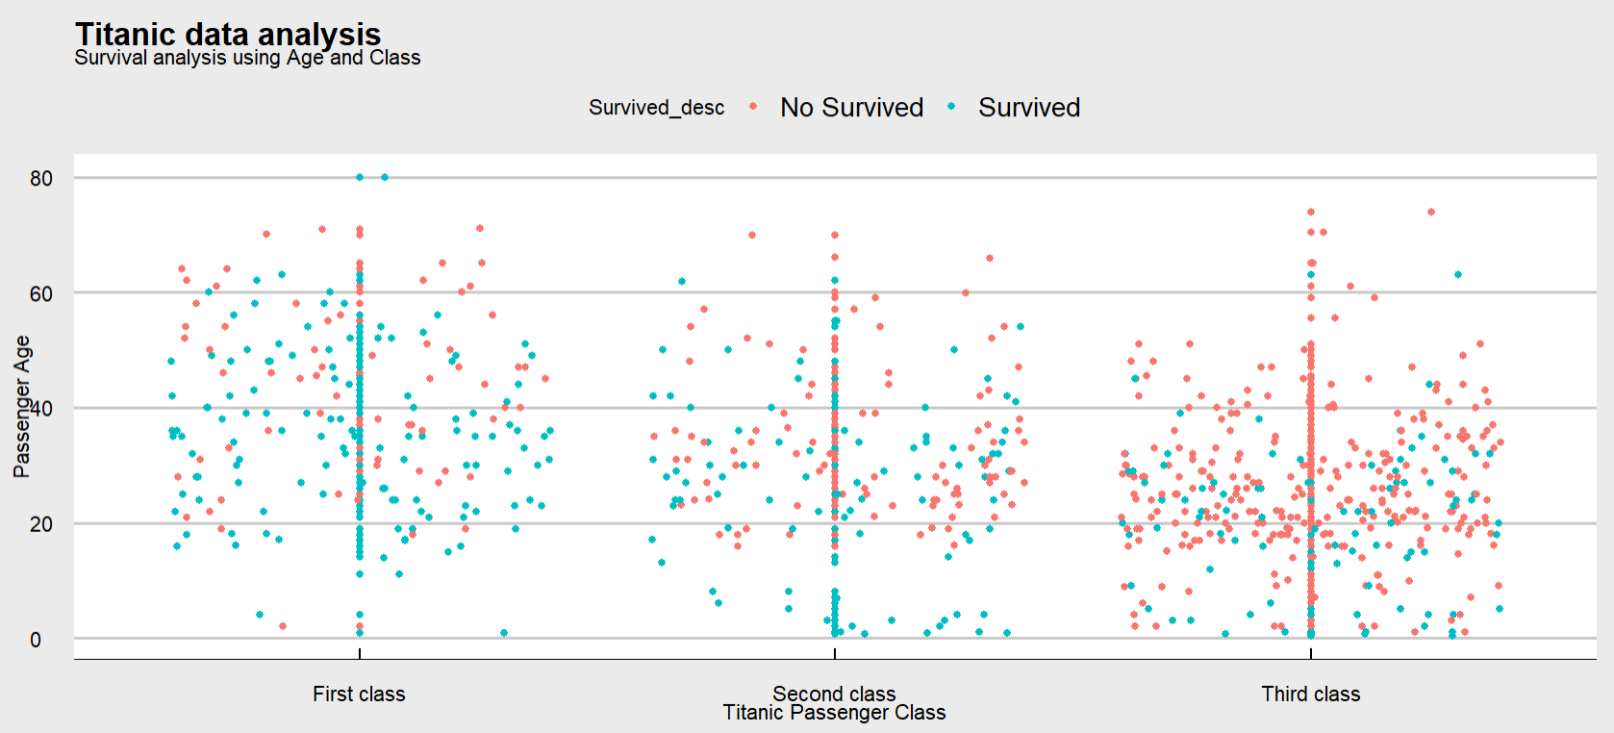
Part 1: Activities:1-3
Sinking of the titanic: Survival analysis using the passenger age and passenger ship class

Slide 8
Part 1: Activities:1-3
Analysis
We want to analyze the plot before using KNN
There are many conclusions we can make right away by taken a quick overview to the image:
1-The passengers in First Class has a higher survival change than other classes
2-As the people got older had a less opportunity to survive
If you were in third class there was almost zero change of survival
We will take a look at another aspect that will play an important role in the likelihood of getting alive from the titanic sink , however we wanted to corroborate with this data before delving deeper into the analysis

Slide 9
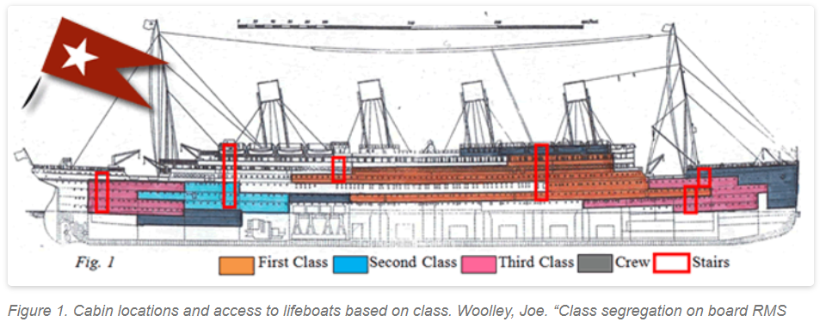
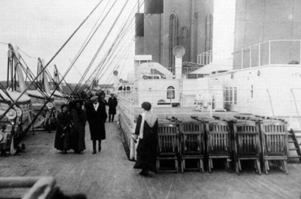
Part 1: Activities:1-3
History
Socioeconomic status on the Titanic created critical boundaries between first-, second-, and third-class passengers
In terms of the physical space that was occupied by each class of passengers, first- and second- class cabins were much closer to the boat deck (where the lifeboats were located) than third class passengers
First- and second-class cabins were primarily separated by purely social barriers whereas physical gates separated the third-class quarters from other areas of the ship
This of course, made accessing lifeboats much easier for first- and second-class passengers, as time is of the essence on a sinking ship
In situations of life and death, a widespread social norm is that the safety of women and children should be prioritized
As the evidence suggests the first class and second class passengers had more chance of survival. On top of that, women and children were prioritize when they were assigning spots in the lifeboats
All of these facts are aligned with what the data suggests

Slide 10
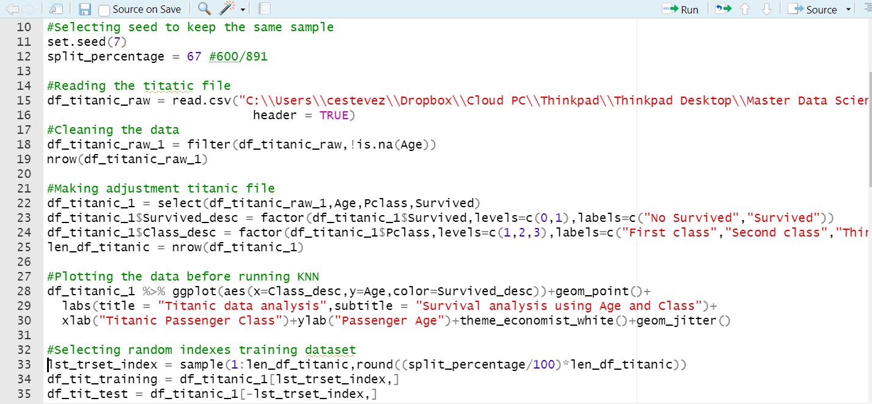
Part 1: Activities:1-3
Reading the file with the information about the titanic accident
We made some adjustments to the file because there was NAN observations
We created a factor variable for the Survival status so it can be more descriptive
We plotted the data of the titanic in order to visualize how Age and Class relate to the Survival likelihood
We created the training data and testing data(We used the percentage because the file only contains 891 observations)
Image 1: Source code: Reading file, data tidyng and creating training and testing dataset

Slide 11
Part 1: Activities:1-3
4.Create a confusion matrix and calculate the accuracy, misclassification rate, sensitivity and specificity. Be prepared to explain these statistics. (It is ok if you have questions here… we will answer them in live session … just do your best.)
5.Pick an age and predict the survival probability of a person that age based on each of the ticket classes.
6.Make a PowerPoint to present in Live Session
7.BONUS: Create separate models for males and females and compare the resulting classification statistics after using the models to classify those in the test set.

Slide 12
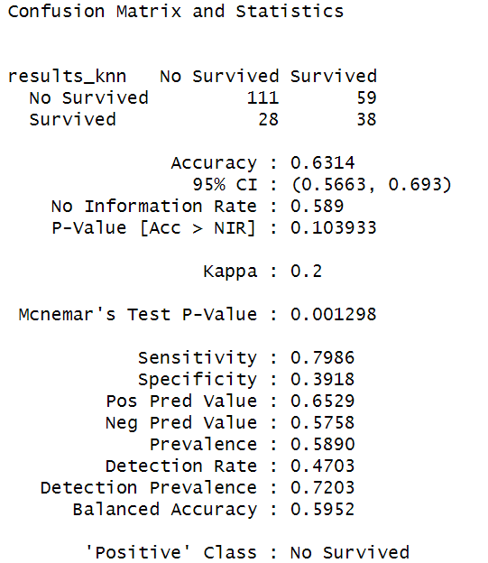
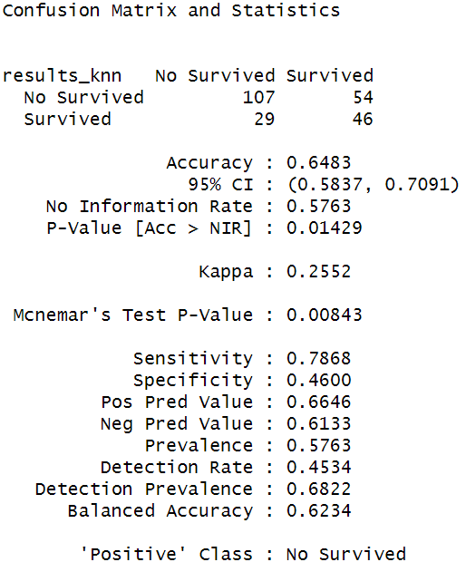
Part 1: Activity:4
Looking to the image we can see the result of the model run using a k equal to 3
The accuracy is 63%, out of 139 people who did not survive the algorithm predicted 111 and in regard to the people who survived the algorithm predicted 59 out of 97
Image 2: Knn results(k=3)
Image 3: Knn results(k=5)

Slide 13
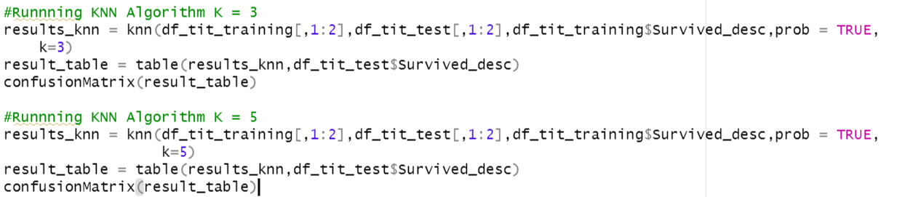
Part 1: Activity:4
We run the KNN model using the training and testing data we created previously
We use confusionmaytrix to estimate the accuracy of the model

Slide 14
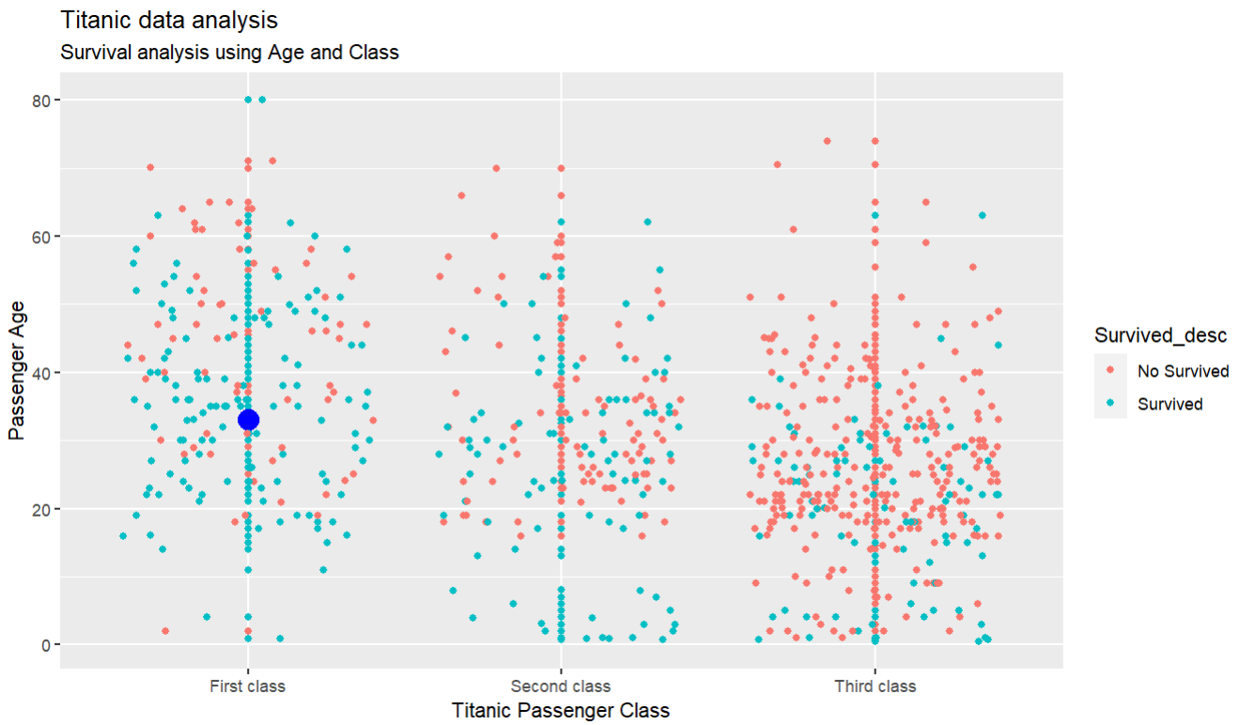
Part 1: Activities:5-6
5.Pick an age and predict the survival probability of a person that age based on each of the ticket classes.
Age = 33, Ticket Class = 1
As we can see in the slide we have decided to choose a middle-age passenger in first class
According to our research this kind of passenger had a high probability of getting alive from the accident
Take a look at the blue circle, the data confirms our research

Slide 15
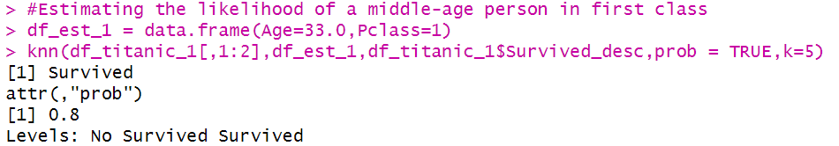
Part 1: Activities:5-6
5.Pick an age and predict the survival probability of a person that age based on each of the ticket classes.
Age = 33, Ticket Class = 1
As we can see in the slide we have decided to choose a middle-age passenger and in first class
According to our research this kind of passenger had a high probability of getting alive from the accident

Slide 16
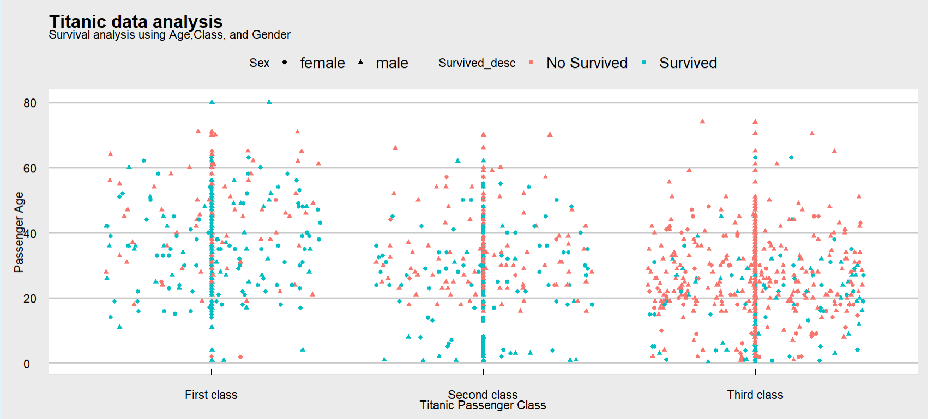
Part 1: Activities:7
7.BONUS: Create separate models for males and females and compare the resulting classification statistics after using the models to classify those in the test set.
As the image shows there’s strong evidence that the gender was a critical factor when it comes to being able to survive or not in the accident
Male
Women

Slide 17
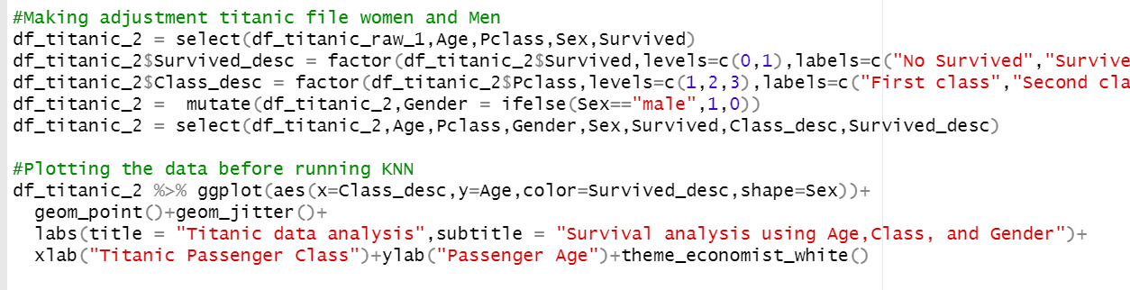
Part 1: Activities:7
7.BONUS: Create separate models for males and females and compare the resulting classification statistics after using the models to classify those in the test set.
Gender model
As we can see here we are considering another variable in the KNN algorithm, instead of two, now we are taking into consideration three: Gender, Class and Age

Slide 18
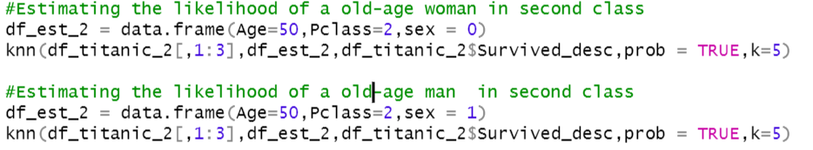
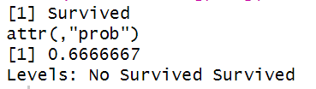
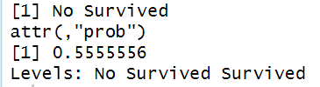
Part 1: Activities:7
7.BONUS: Create separate models for males and females and compare the resulting classification statistics after using the models to classify those in the test set.
Simulation
Man, Age = 50, Class = 2
Woman, Age = 50, Class 2
As we can see from the simulation, the same passenger with the same age had more change of survival if that passenger was a woman
Woman
Man

Slide 19
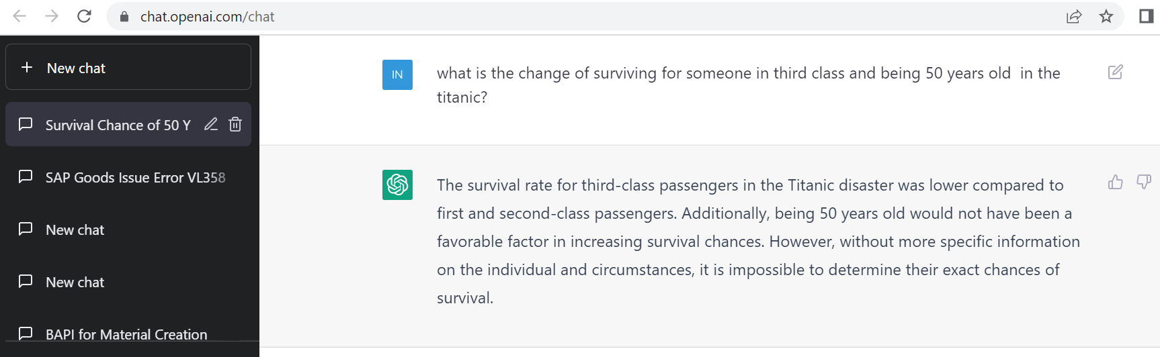
Part 1: ChatGPT
What ChatGPT is answering is really in alignment with the data and the initial plot in the presentation
The changes of survival in third class was really very low

Slide 20
Part 2: Activity 1
a. For the full (multinomial) IRIS data (the iris dataset in R), do a 70-30 train/test cross validation with k =1 - 90 and use sepal length and width as predictors. Make a plot of k (xaxis) versus accuracy. Use this plot to tune the hyperparameter k. What do you feel is the best value of k?

Slide 21
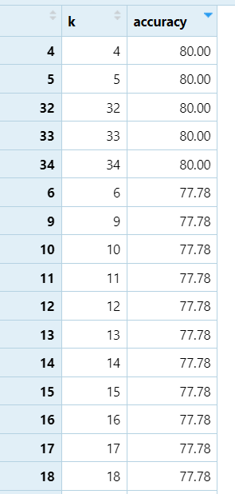
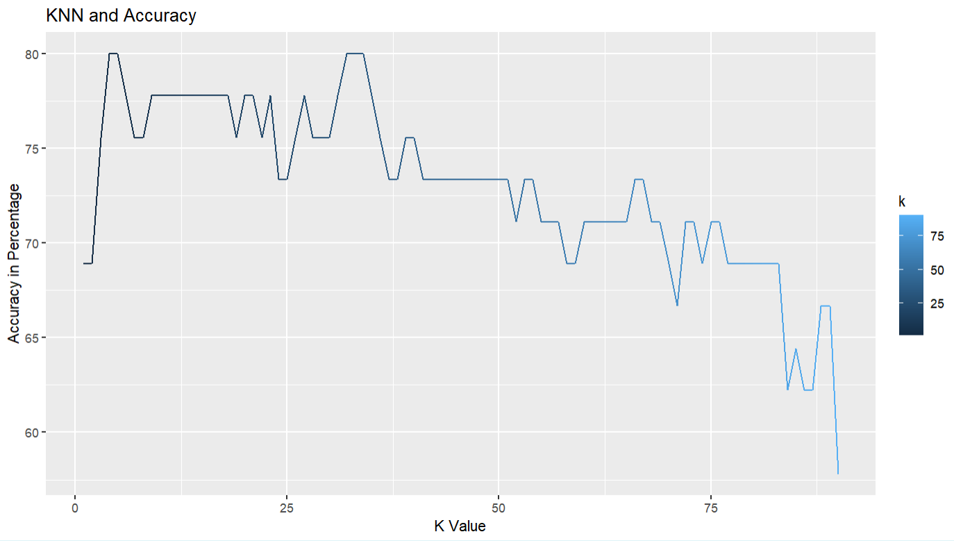
Part 2: Activity:1
As we can see from the plot the best value for K is between 4 and 5 with an accuracy of 80%

Slide 22
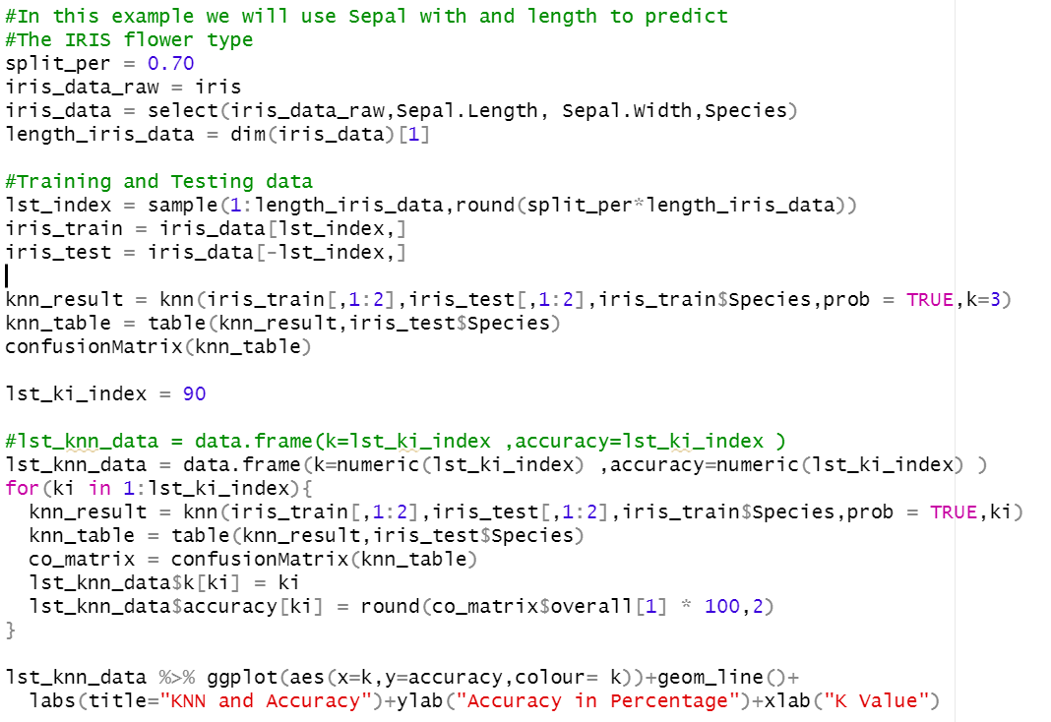
Part 2: Activity:1
We select the column we are interested for our model
We create the training and testing dataset
We loop from 1 to 90 in order to determine the best possible K in terms of the highest accuracy
We plot the K data frame

Slide 23
Part 2: Activity 2
BONUS: Repeat the above analysis with a leave one out cross-validation.

Slide 24
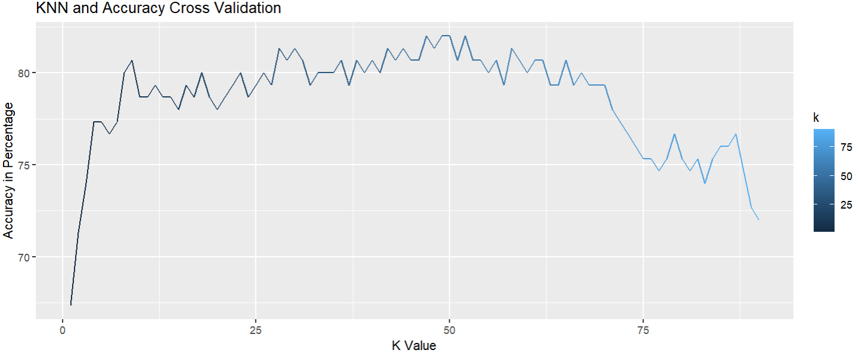
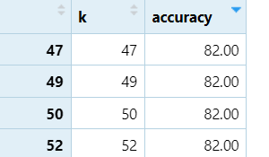
Part 2: Activity 2:
As we can see from the plot the best value for K is 42 with an accuracy of 80%

Slide 25
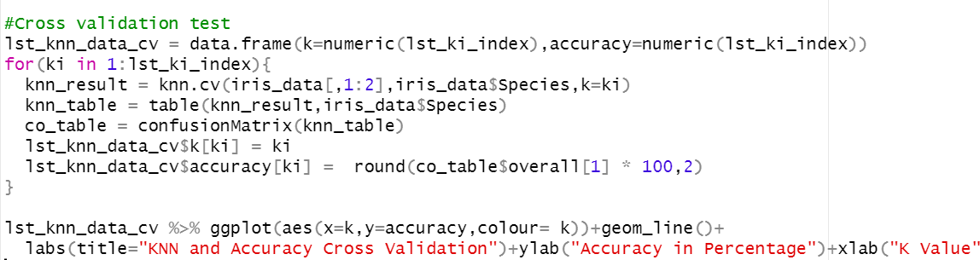
Part 2: Activity:2
We mostly did the same thing however, we use the KNN function for cross validation
We don’t need a testing or training dataset when we are using cross validation

Slide 26
Takeaway and Questions
Takeaways:
It was really a great experience using a ML model to predict the end result of an event given a certain number of variables
KNN is very powerful when the number of observations is significant, however, when the amount of data is not representative, I don’t know if the model will predict well
Questions
When it comes to Email Spam detection, do they use KNN or Naïve Bayes?

